Slide 1
Chapter 4: The Selection Structure

Slide 2
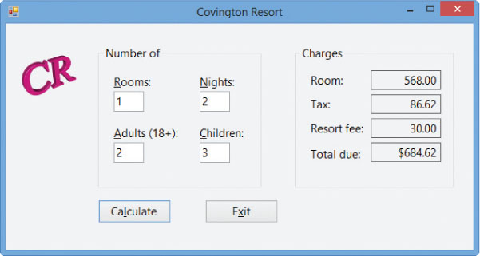
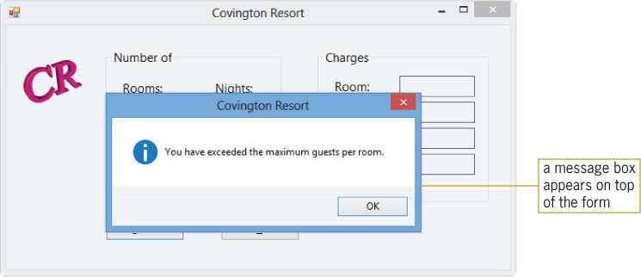
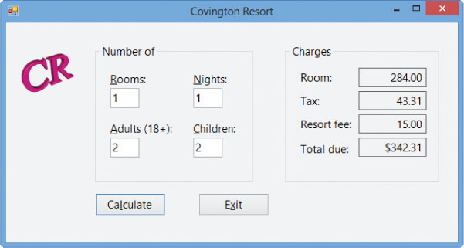
Previewing the Covington Resort Application
Figure 4-1 Interface showing the calculated amounts
Figure 4-2 Message box
Figure 4-3 New charges shown in the interface

Slide 3
Lesson A Objectives
After studying Lesson A, you should be able to:
Write pseudocode for the selection structure
Create a flowchart to help you plan an application’s code
Write an If…Then…Else statement
Include comparison operators in a selection structure’s condition
Include logical operators in a selection structure’s condition
Change the case of a string

Slide 4
Making Decisions in a Program
Three basic control structures:
Sequence
Selection
Repetition
All procedures in an application are written using one or more of these structures
Procedures in previous chapters used the sequence structure only
A condition in a selection structure gives an answer of either true or false

Slide 5
Making Decisions in a Program (cont.)
Single-alternative selection structure
Tasks are performed only when its condition is true
Dual-alternative selection structure
One set of tasks is performed if its condition is true
Called the true path
A different set of tasks is performed if its condition is false
Called the false path
The words “if” and “end if” denote a selection structure’s beginning and end
The word “else” denotes the beginning of the false path

Slide 6
Flowcharting a Selection Structure
Decision symbol
Used to represent the condition (decision) in both the selection and repetition structures
Other symbols:
Oval: Start/stop symbol
Rectangle: Process symbol
Parallelogram: Input/output symbol

Slide 7
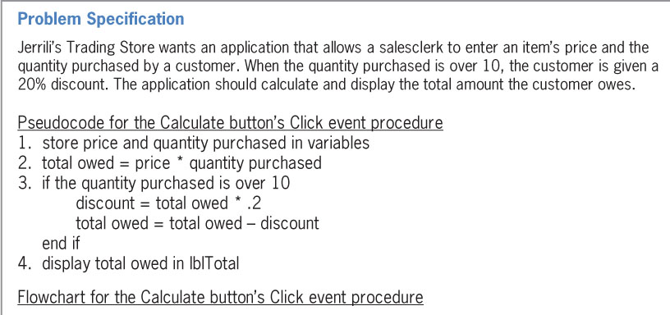
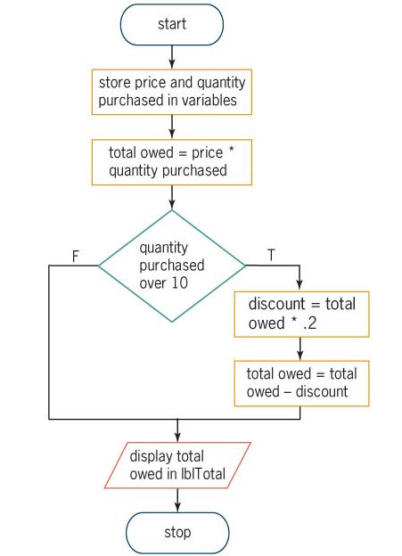
Flowcharting a Selection Structure (cont.)
Figure 4-7 Pseudocode and flowchart showing a single-alternative selection structure

Slide 8
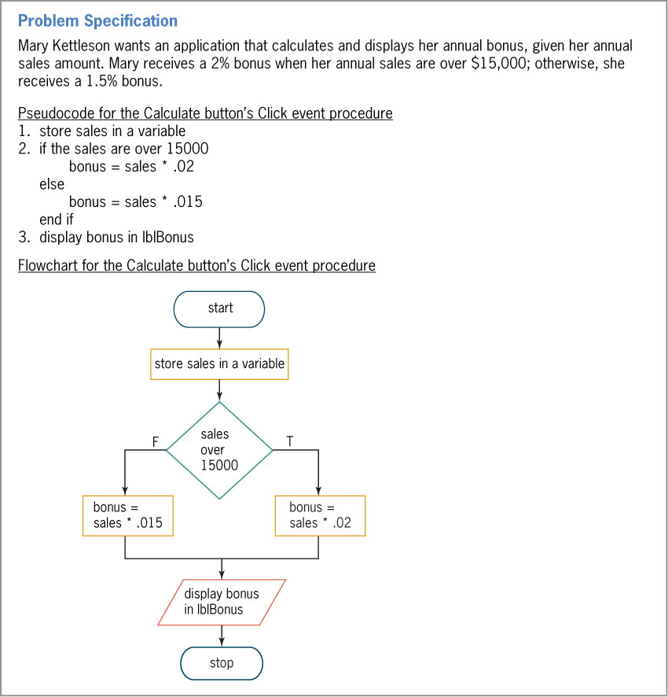
Flowcharting a Selection Structure (cont.)
Figure 4-8 Pseudocode and flowchart showing a dual-alternative selection structure

Slide 9
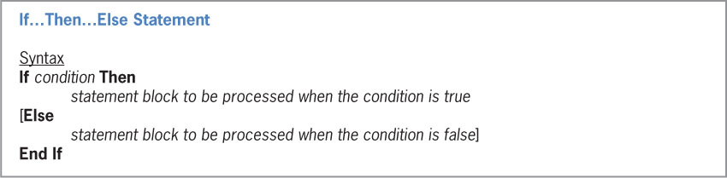
Coding Selection Structures in Visual Basic
If…Then…Else statement
Used to code single and dual-alternative selection structures
Statement block
The set of statements in each path
Figure 4-9 Syntax and examples of the If…Then…Else statement (continues)

Slide 10
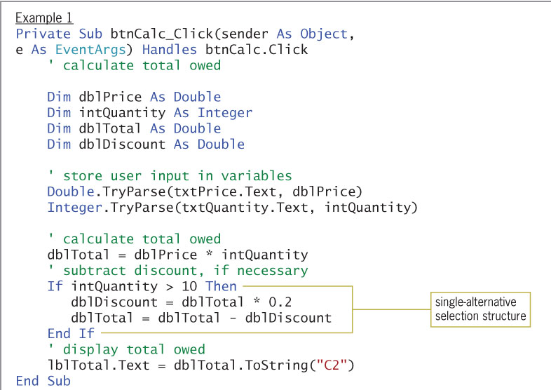
Coding Selection Structures in Visual Basic

Slide 11
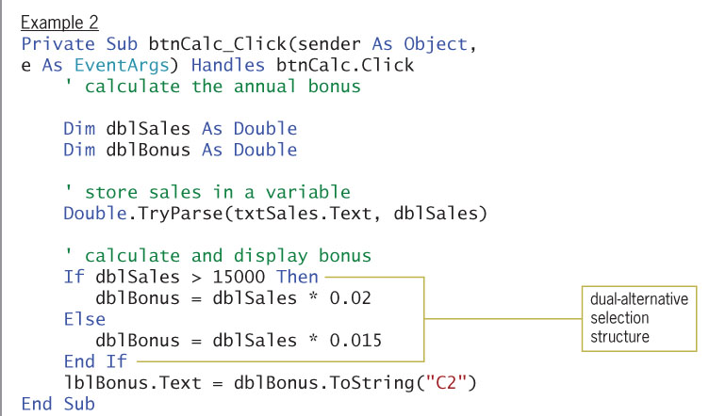
Coding Selection Structures in Visual Basic

Slide 12
Comparison Operators
Comparison operators
Used to compare two values
Always result in a True or False value
Rules for comparison operators:
They do not have an order of precedence
They are evaluated from left to right
They are evaluated after any arithmetic operators in the expression

Slide 13
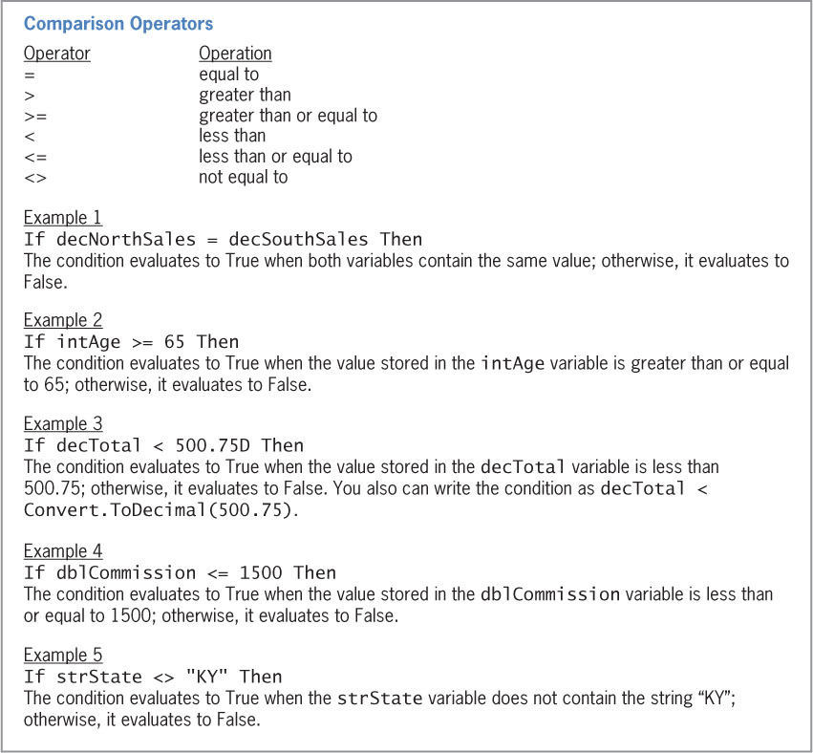
Comparison Operators (cont.)
Figure 4-12 Listing and examples of commonly used comparison operators

Slide 14
You Do It!
Try You Do It 1 on page 195

Slide 15
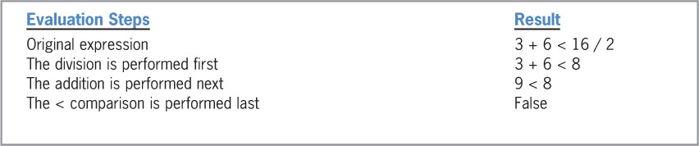
Comparison Operators (cont.)
Figure 4-13 Evaluation steps for expressions containing arithmetic and comparison operators (continues)

Slide 16
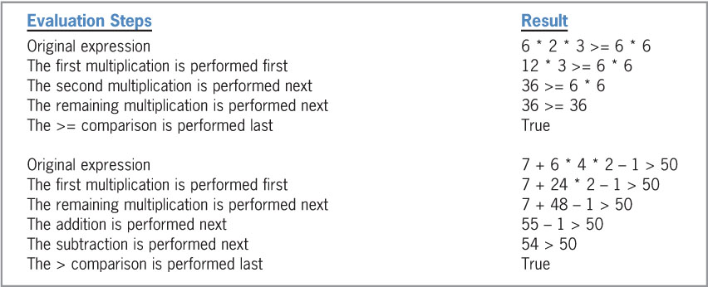
Comparison Operators (cont.)
(continued)
Figure 4-13 Evaluation steps for expressions containing arithmetic and comparison operators

Slide 17
You Do It!
Try You Do it 2 on page 197

Slide 18
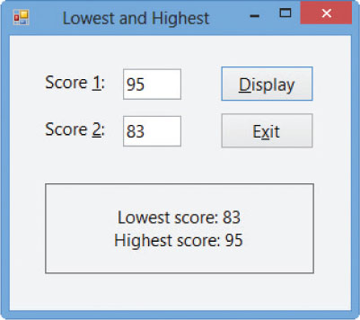
Comparison Operators (cont.)
Using Comparison Operators: Swapping Numeric Values
Uses a single-alternative selection structure to determine if one number is greater than another
Figure 4-14 Sample run of the Lowest and Highest application

Slide 19
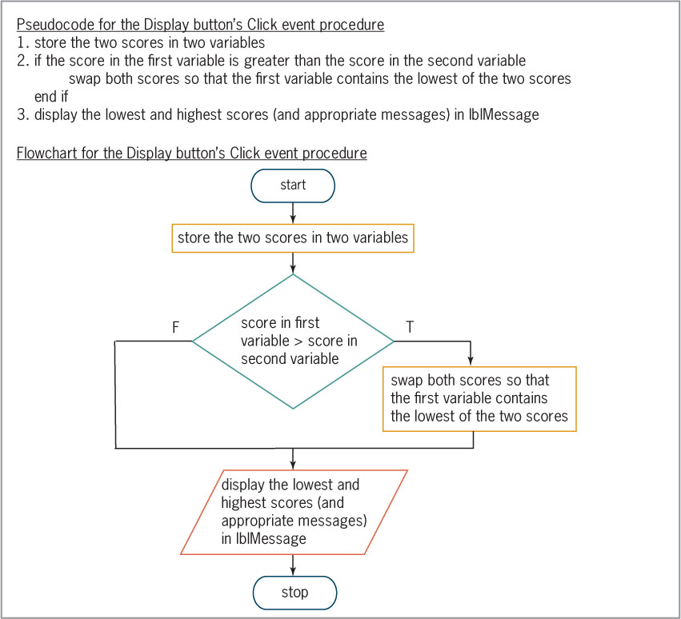
Comparison Operators (cont.)
Figure 4-15 Pseudocode and flowchart containing a single-alternative selection structure

Slide 20
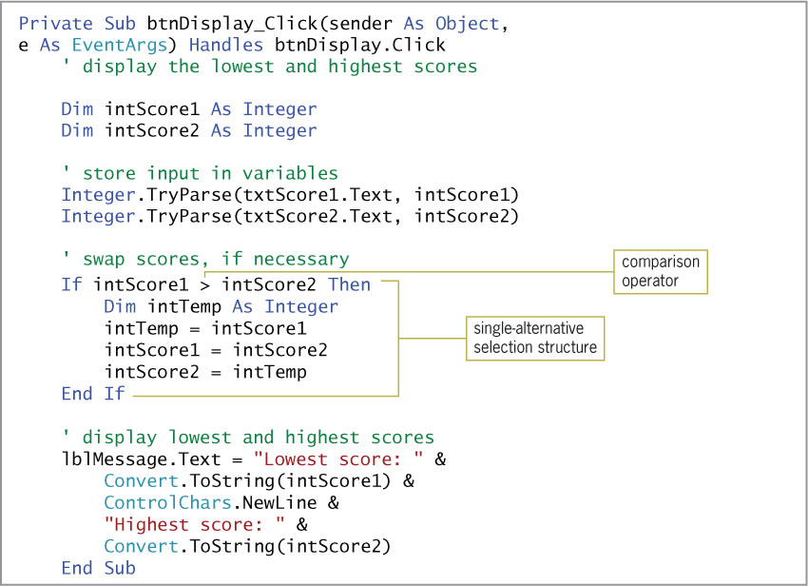
Comparison Operators (cont.)
Figure 4-16 Display button’s Click event procedure

Slide 21
Comparison Operators (cont.)
Values input by the user are stored in variables with procedure scope
A temporary variable is used when values must be swapped
Declared within a statement block
Block-level variable
Block scope
Restricts the use of a variable to the statement block in which it is declared

Slide 22
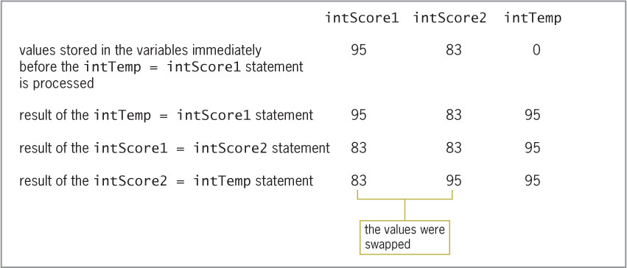
Comparison Operators (cont.)
Figure 4-17 Illustration of the swapping concept

Slide 23
Code on Page 200

Slide 24
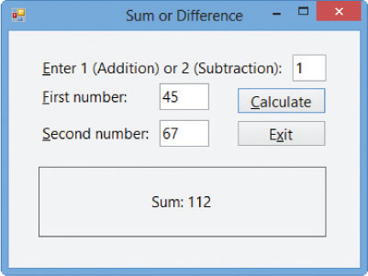
Comparison Operators (cont.)
Using Comparison Operators: Displaying the Sum or Difference
Uses a dual-alternative selection structure to determine either the sum of or the difference between two numbers
Figure 4-18 Sample run of the Sum or Difference application

Slide 25
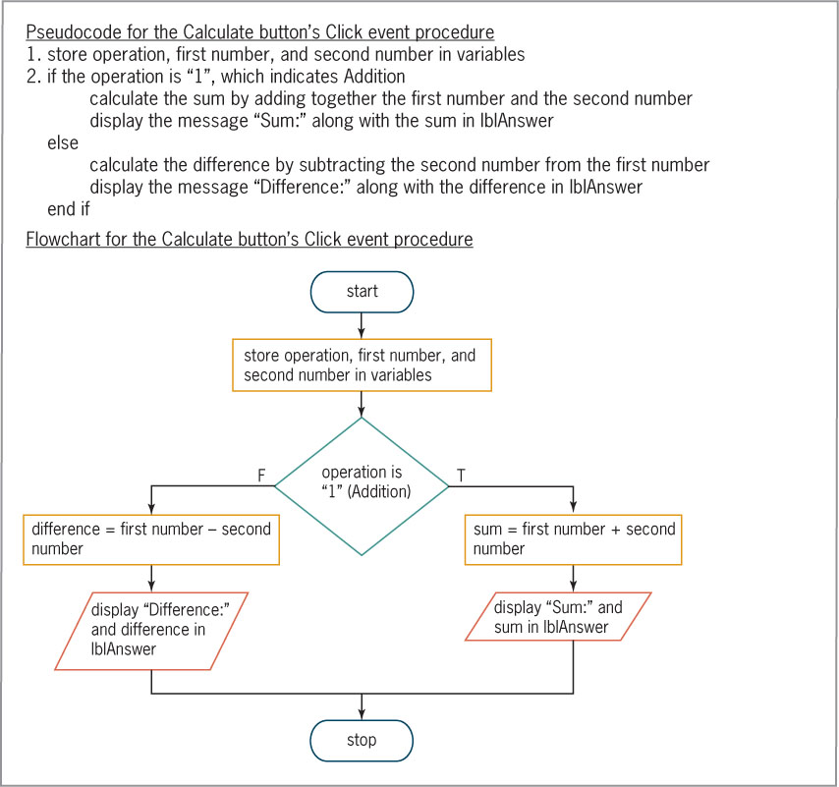
Comparison Operators (cont.)
Figure 4-19 Flowchart and pseudocode containing a dual-alternative selection structure

Slide 26
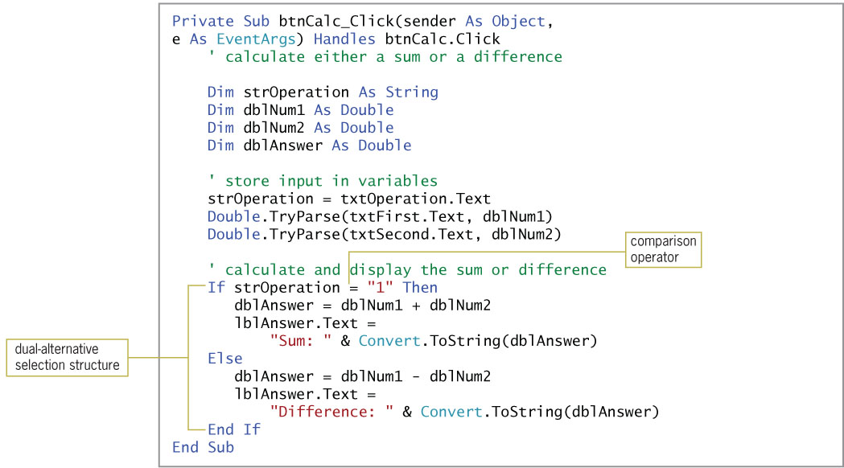
Comparison Operators (cont.)
Figure 4-20 Calculate button’s Click event procedure

Slide 27
Code the Sum or Difference Application
You Do it #3 on page 203
You Do it #4 on page 203

Slide 28
Logical Operators
Logical operators
Used to create compound conditions
Expressions evaluate to a Boolean value
True or False
Six logical operators in Visual Basic:
Not
And
AndAlso
Or
OrElse
Xor

Slide 29
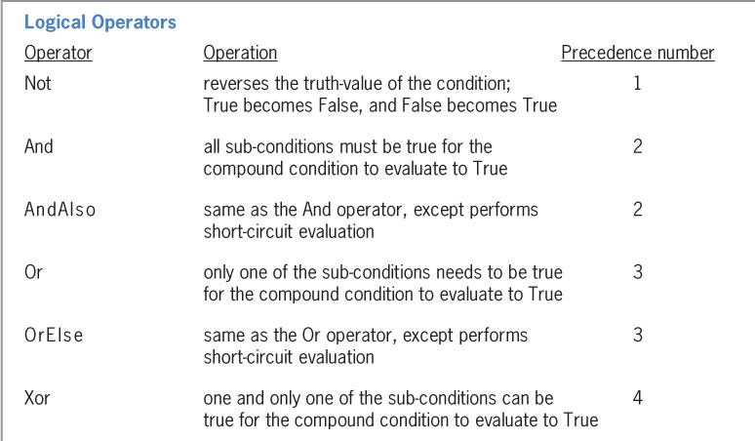
Logical Operators (cont.)
Figure 4-21 Listing and examples of logical operators (continues)

Slide 30
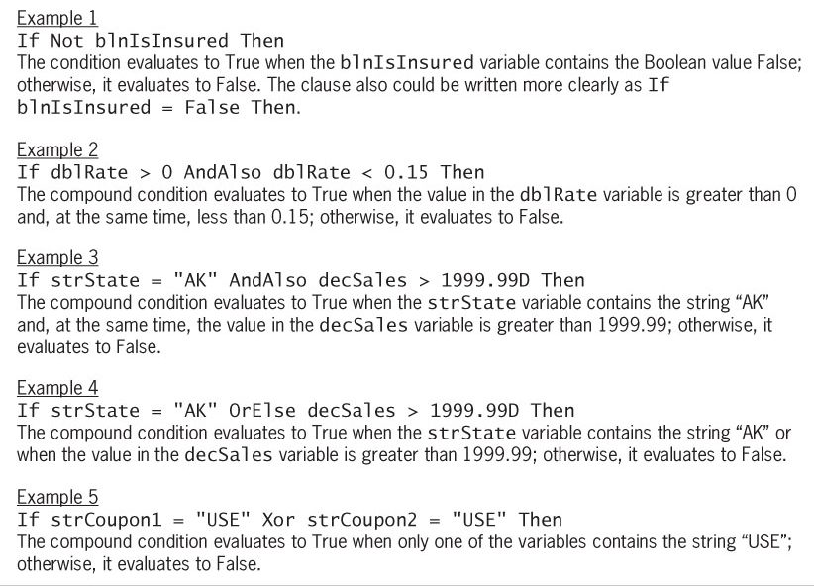
Logical Operators (cont.)
(continued)
Figure 4-21 Listing and examples of logical operators

Slide 31
Logical Operators (cont.)
Truth tables
Show how logical operators are evaluated
Not operator
Reverses the truth-value of the condition
And operator and AndAlso operator
Both operators combine two sub-conditions
The And operator always evaluates both conditions
AndAlso performs a short-circuit evaluation, which bypasses the evaluation of a condition when the outcome can be determined without it
The compound condition evaluates to true only when both conditions are true

Slide 32
Logical Operators (cont.)
Or operator or OrElse operator
Both operators combine two sub-conditions
The compound condition evaluates to true when either or both conditions are true
OrElse is more efficient than Or
As soon as a condition is found to be true, no further conditions are tested and the compound condition is true
Using the Truth Tables
You can use AndAlso and Xor

Slide 33
Logical Operators (cont.)
Logical Operators: Calculating Gross Pay
Scenario: Calculate and display employee gross pay
Requirements for the application:
Verify that hours are within a range (>= 0.0 and <= 40.0)
If the data is valid, calculate and display the gross pay
If the data is not valid, display an error message
You can accomplish this using AndAlso or OrElse
Data validation
Verifying that input data is within the expected range

Slide 34
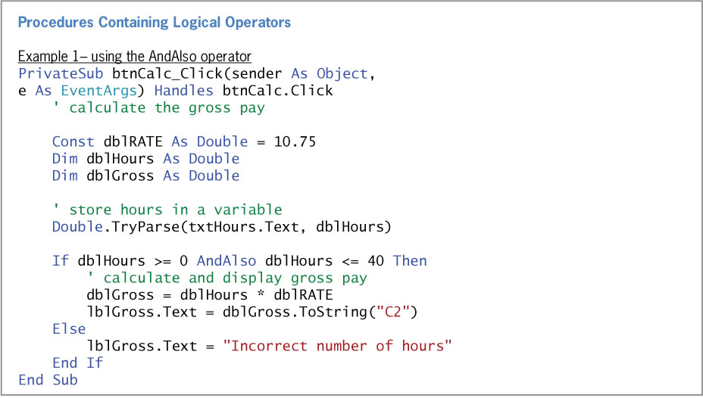
Logical Operators (cont.)
Figure 4-23 Examples of using the AndAlso and OrElse logical operators (continues)

Slide 35
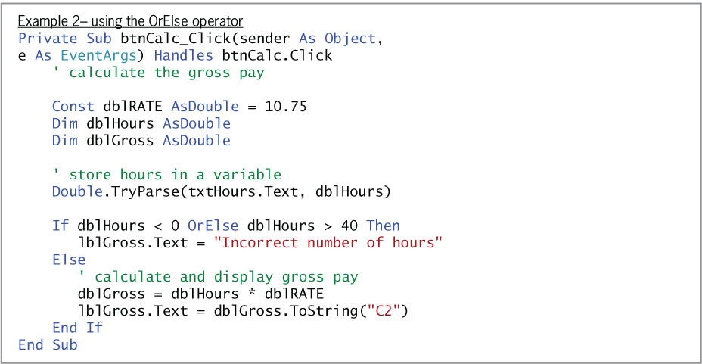
Logical Operators (cont.)
(continued)
Figure 4-23 Examples of using the AndAlso and OrElse logical operators

Slide 36
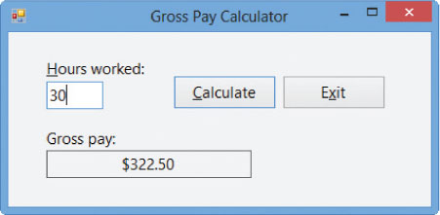
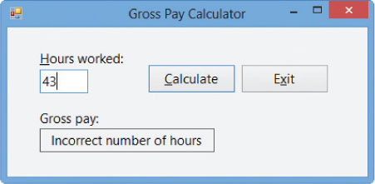
Logical Operators (cont.)
Figure 4-24 Sample run of the application using valid data
Figure 4-25 Sample run of the application using invalid data

Slide 37
You Do it!
Code the Gross pay calculator on page 208
Complete You Do it 5 on page 209

Slide 38
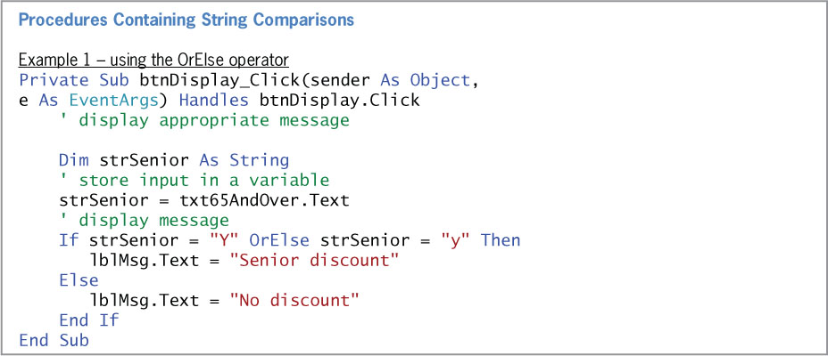
Comparing Strings Containing Letters
Figure 4-26 Examples of using string comparisons in a procedure (continues)

Slide 39
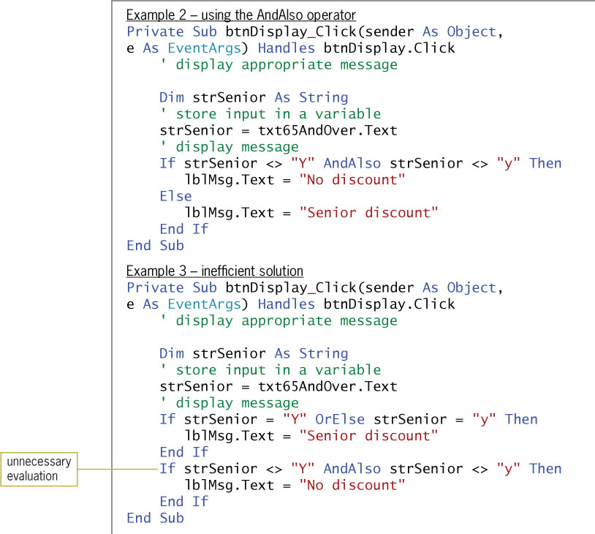
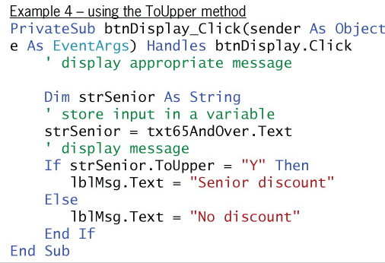
Comparing Strings Containing Letters (cont.)
(continued)
Figure 4-26 Examples of using string comparisons in a procedure

Slide 40
Converting a String to Uppercase or Lowercase
String comparisons are case sensitive
CharacterCasing property:
Three case values: Normal (default), Upper, Lower
ToUpper method
Converts the string to uppercase
Example: If strSenior.ToUpper = "y"
ToLower method
Converts the string to lowercase

Slide 41
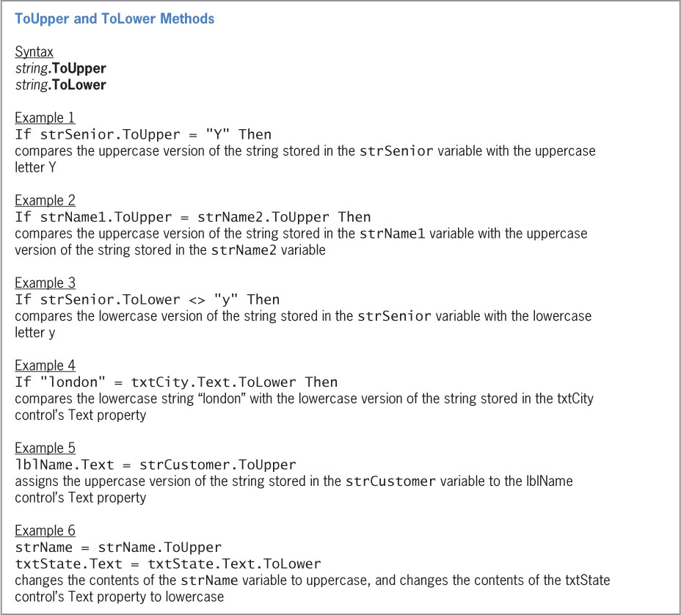
Converting a String to Uppercase or Lowercase (cont.)
Figure 4-27 Syntax and examples of the ToUpper and ToLower methods

Slide 42
Converting a String to Uppercase or Lowercase (cont.)
Using the ToUpper and ToLower Methods: Displaying a Message
Procedure requirements:
Display the message: “We have a store in this state”
Valid states: IL, IN, KY
Must handle case variations in the user’s input
Can use ToLower or ToUpper
Can assign a string variable to the input text box’s value converted to uppercase

Slide 43
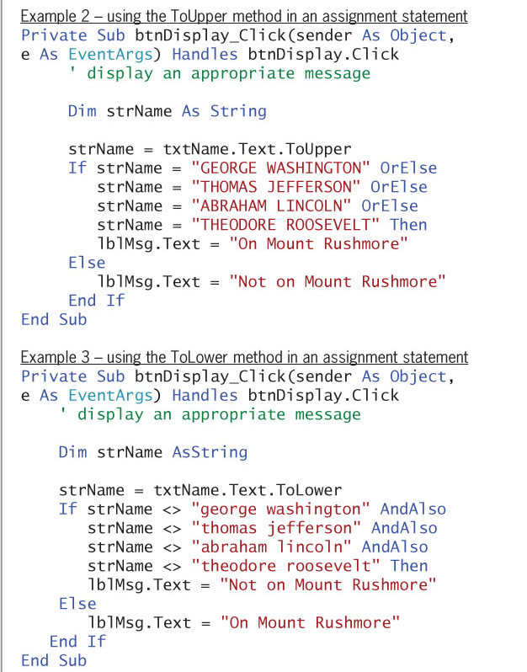
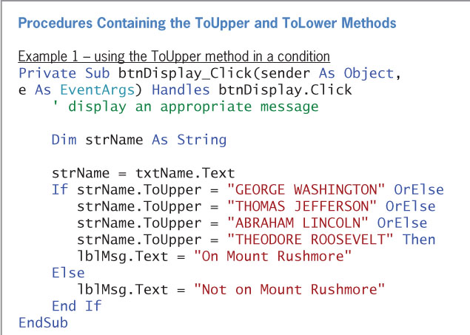
Converting a String to Uppercase or Lowercase (cont.)
Figure 4-28 Examples of using the ToUpper and ToLower methods in a procedure

Slide 44
Code Mount Rushmore on page 214
Complete You do it 6 on page 216

Slide 45
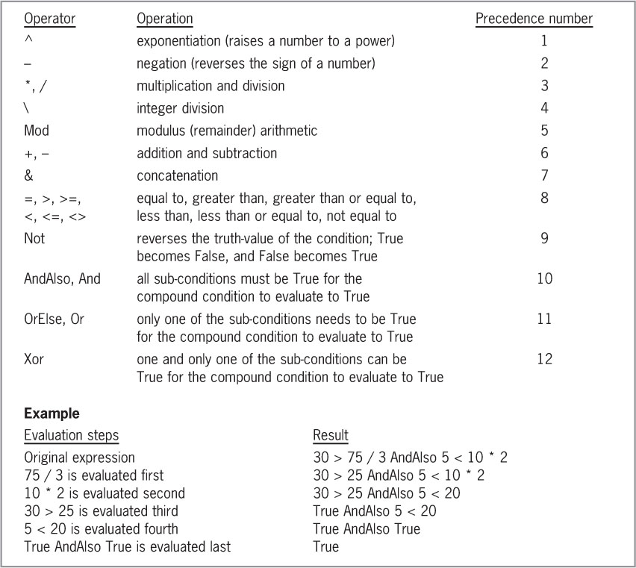
Summary of Operators
Figure 4-30 Listing of arithmetic, concatenation, comparison, and logical operators

Slide 46
Lesson A Summary
Single and dual-alternative selection structures
Use the If...Then...Else statement
Use comparison operators to compare two values
Use a temporary variable to swap values contained in two variables
Use logical operators to create a compound condition
Use the text box’s CharacterCasing property to change text to upper- or lowercase
Use ToUpper and ToLower to temporarily modify the case of input text

Slide 47
Homework
Complete Exercise 15 on page 221

Slide 48
Lesson B Objectives
After studying Lesson B, you should be able to:
Group objects using a GroupBox control
Create a message box using the MessageBox.Show method
Determine the value returned by a message box

Slide 49
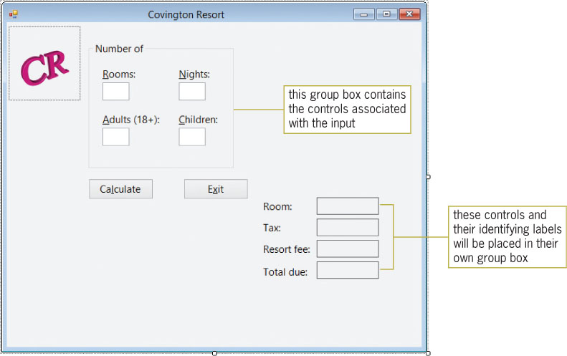
Creating the Covington Resort Application
Figure 4-33 Partially completed interface for Covington Resort

Slide 50
Creating the Covington Resort Application (cont.)
Adding a Group Box to the Form
Group box
A container control for other controls
GroupBox tool
Used to add a group box control to the interface
The group box control provides:
Visual separation of related controls
The ability to manage the grouped controls by manipulating the group box control
Lock controls to ensure that they are not moved
Be sure to set the TabIndex after the placement of controls

Slide 51
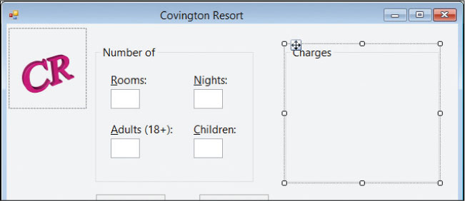
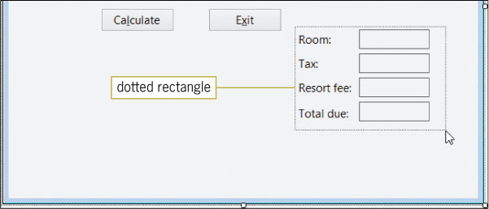
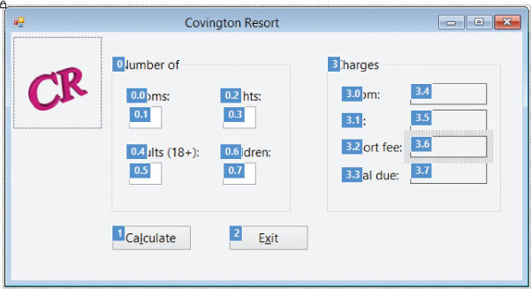
Creating the Covington Resort Application (cont.)
Figure 4-34 Interface showing the location and size of the additional group box
Figure 4-35 Dotted rectangle surrounding the eight controls
Figure 4-36 Correct TabIndex values for the interface

Slide 52
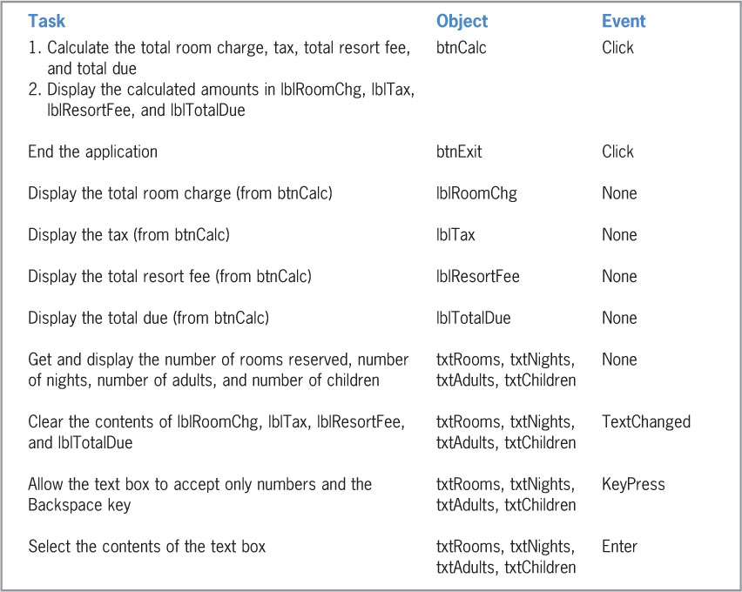
Coding the Covington Resort Application
Figure 4-37 TOE chart for the Covington Resort application

Slide 53
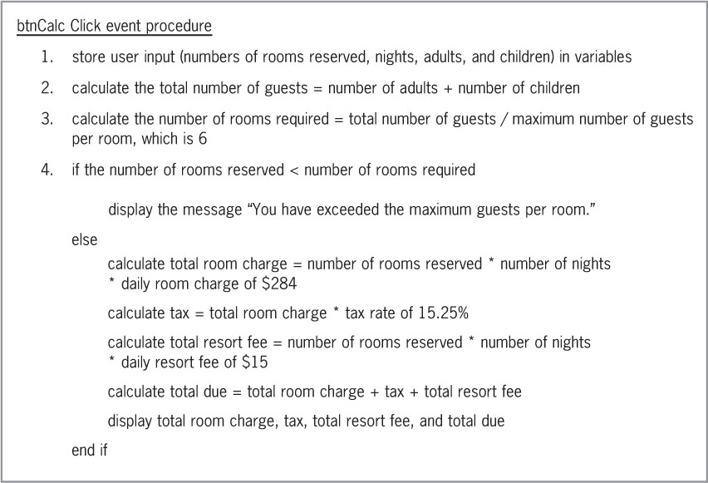
Coding the Covington Resort Application (cont.)
Coding the btnCalc Control’s Click Event Procedure
Figure 4-38 Pseudocode for the btnCalc control’s Click event procedure

Slide 54
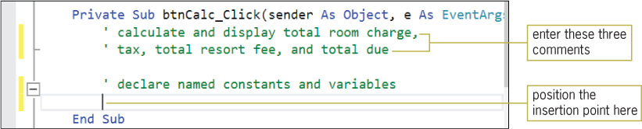
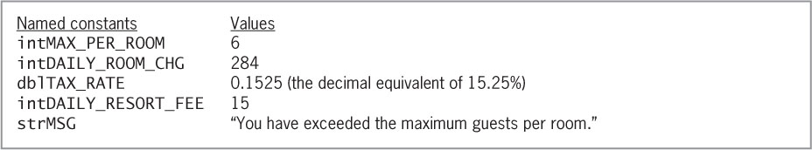
Coding the Covington Resort Application (cont.)
Figure 4-39 Comments and Dim statements entered in the procedure
Figure 4-40 Listing of named constants and their values

Slide 55
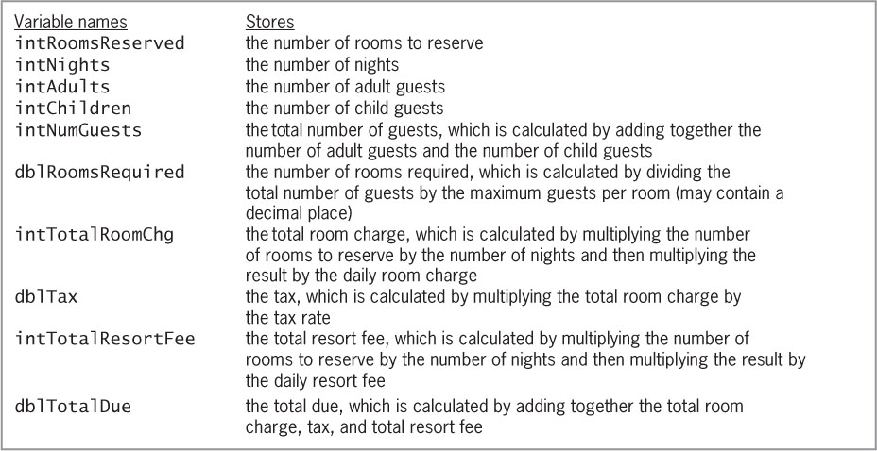
Coding the Covington Resort Application (cont.)
Figure 4-41 Listing of variables and what each stores

Slide 56
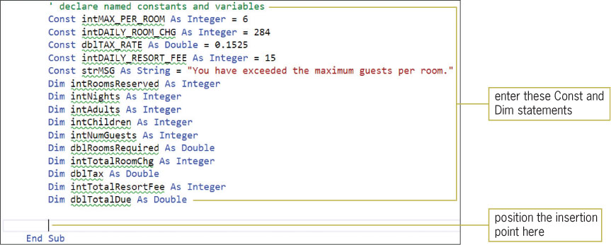
Coding the Covington Resort Application (cont.)
Figure 4-42 Const and Dim statements entered in the procedure

Slide 57
The MessageBox.Show Method
MessageBox.show method
Displays the message box with a text message, a caption, a button or buttons, and an icon
Use sentence capitalization for the text message
Use book title capitalization for the caption
Icons:
Exclamation or question mark: Indicates the user must make a decision before continuing
Information: Indicates an informational message
Stop: Indicates a serious problem

Slide 58
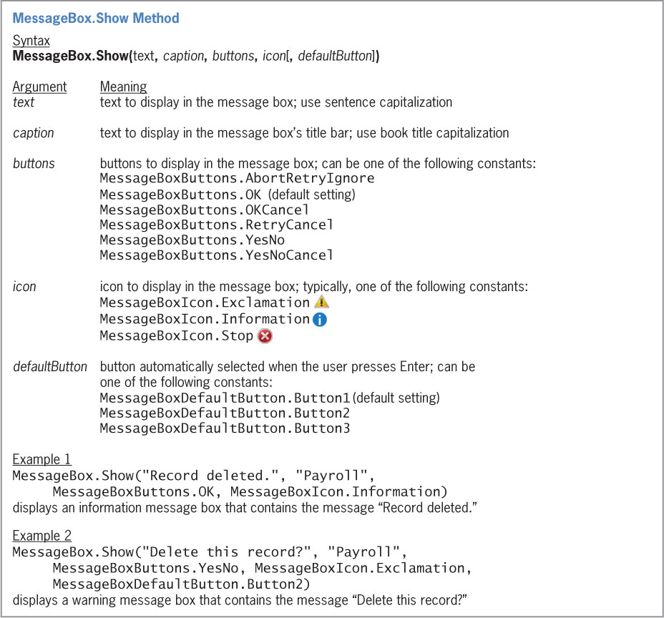
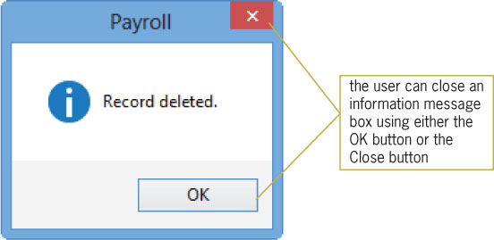
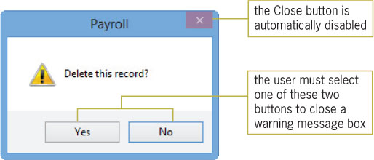
The MessageBox.Show Method (cont.)
Figure 4-44 Message displayed by the code in Example 1 in Figure 4-43
Figure 4-45 Message displayed by the code in Example 2 in Figure 4-43
Figure 4-43 Syntax and examples of the MessageBox.Show method

Slide 59
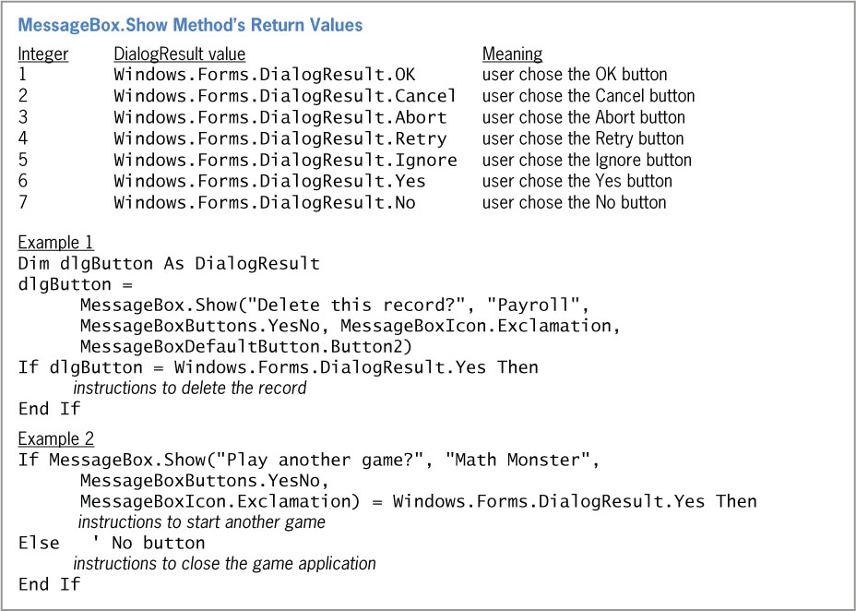
The MessageBox.Show Method (cont.)
Figure 4-46 Values returned by the MessageBox.Show method

Slide 60
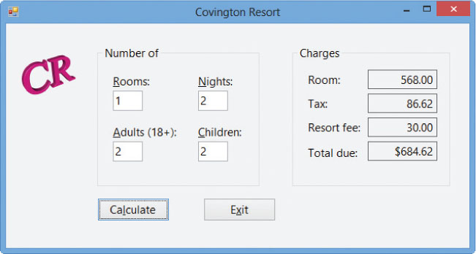
Completing the btnCalc_Click Procedure
Complete the false path of the selection structure
Calculate and display the total room charge, tax, total resort fee, and total due
Figure 4-48 Calculated amounts shown in the interface

Slide 61
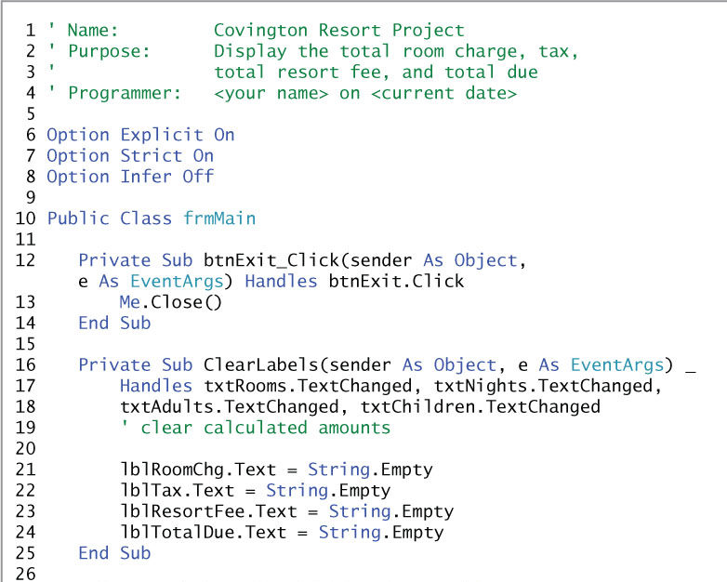
Completing the btnCalc_Click Procedure (cont.)
Figure 4-49 Covington Resort application’s code at the end of Lesson B (continues)

Slide 62
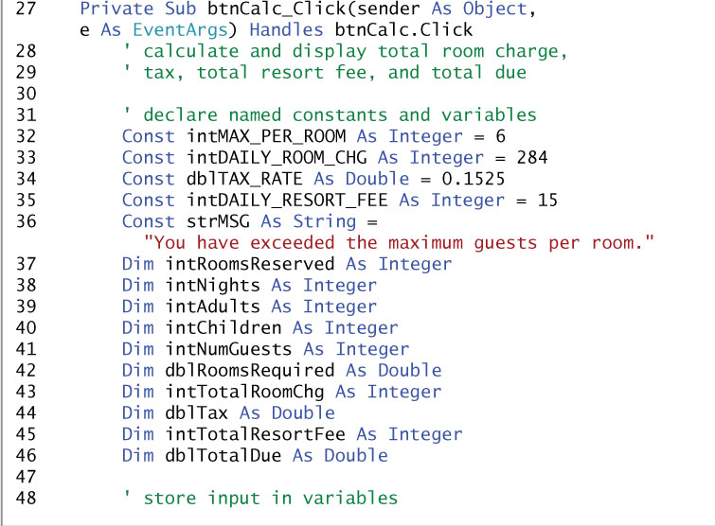
Completing the btnCalc_Click Procedure (cont.)
(continued)
Figure 4-49 Covington Resort application’s code at the end of Lesson B (continues)

Slide 63
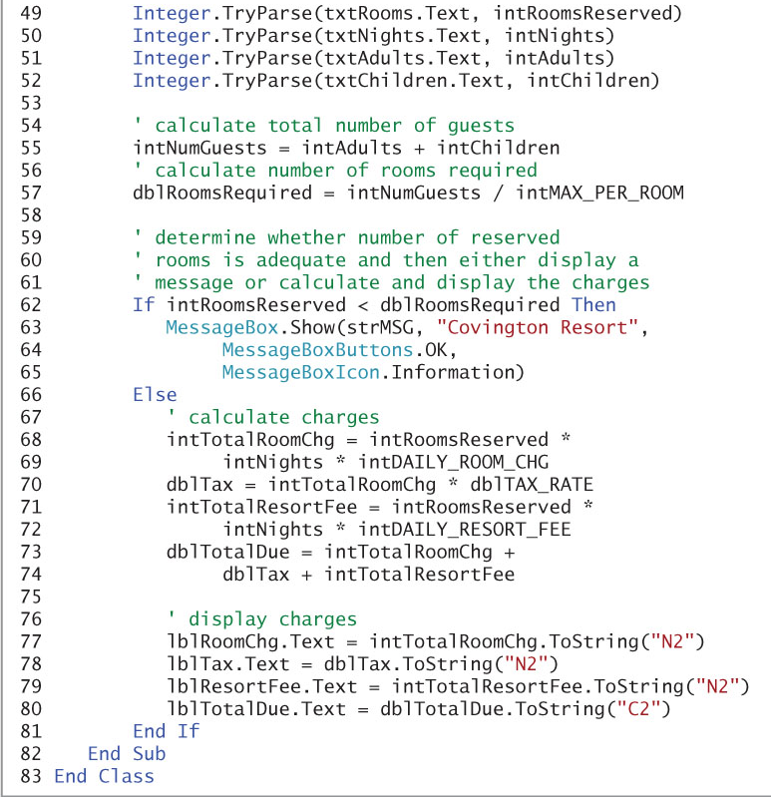
Completing the btnCalc_Click Procedure (cont.)
(continued)
Figure 4-49 Covington Resort application’s code at the end of Lesson B

Slide 64
Lesson B Summary
A group box is a container control that treats its contents as one unit
Use the GroupBox tool to add a group box
The MessageBox.Show method displays a message box with text, one or more buttons, and an icon

Slide 65
Lesson C Objectives
After studying Lesson C, you should be able to:
Prevent the entry of unwanted characters in a text box
Select the existing text in a text box

Slide 66
Coding the KeyPress Event Procedures
KeyPress event
Occurs when a key is pressed while the control has the focus
The character corresponding to the pressed key is sent to the KeyPress event’s e parameter
The KeyPress event can be used to prevent users from entering inappropriate characters
Use the e parameter’s KeyChar property to determine the pressed key
Use the Handled property to cancel the key if necessary

Slide 67

Coding the KeyPress Event Procedures (cont.)
Figure 4-53 Examples of using the KeyChar and Handled properties in the KeyPress event procedure

Slide 68

Coding the KeyPress Event Procedures (cont.)
Figure 4-54 CancelKeys procedure

Slide 69

Coding the Enter Event Procedures
Figure 4-55 Syntax and an example of the SelectAll method

Slide 70

Coding the Enter Event Procedures (cont.)
Figure 4-57 Covington Resort application’s code at the end of Lesson C (continues)

Slide 71

Coding the Enter Event Procedures (cont.)
(continued)
Figure 4-57 Covington Resort application’s code at the end of Lesson C (continues)

Slide 72

Coding the Enter Event Procedures (cont.)
(continued)
Figure 4-57 Covington Resort application’s code at the end of Lesson C (continues)

Slide 73

Coding the Enter Event Procedures (cont.)
(continued)
Figure 4-57 Covington Resort application’s code at the end of Lesson C (continues)

Slide 74

Coding the Enter Event Procedures (cont.)
(continued)
Figure 4-57 Covington Resort application’s code at the end of Lesson C

Slide 75
Lesson C Summary
The KeyPress event occurs when the user presses a key
Use the KeyPress event to cancel an unwanted key pressed by the user
Use the SelectAll method to select all contents of a text box
The Enter event occurs when the text box receives the focus
Use the Enter event to process code when the control receives the focus

